Slide 1
Mapping campus sexual assaults
Shannon Turner
Twitter: @svt827
GitHub: @shannonturner

Slide 2
The goal
Create a map using data we've collected. http://shannonvturner.com/seriously/
This is a map of colleges that reported having zero sexual assaults from 2010-2012.

Slide 3
problem definition
An estimated 1 in 5 women will experience sexual assault while in college.
But schools aren't treating it like an epidemic.
Why aren't schools taking this seriously?
How to change the culture of victim-blaming, minimizing, and covering it up?
How to ensure survivors get help and support they need?

Slide 4
ideation
Underreporting is a major problem.
I don't want to encourage schools to cover up the problem by shaming the schools with the highest numbers.
How to motivate schools? Go after their reputation.
Do they want to be known as a school that covers up campus sexual assault?

Slide 5
focus
What will have the greatest impact?
My choice: I'll focus on the schools that reported zero sexual assaults.
This assumes I'll be able to find data on how many sexual assaults occurred on each campus.
Though if I'm unable to find this information, that's a powerful conversation starter.

Slide 6
the elevator pitch
I want to create a map that shows the colleges and universities that reported having zero sexual assaults on their campus.

Slide 7
We can do this if we can …
Define the outcome
Find data on campus sexual assaults
Preferably one unified data set, with all schools over the same period
For each school, find its location
For each location, put a pin on a map

Slide 8
the data!
http://apps.washingtonpost.com/g/page/local/sex-offenses-on-us-college-campuses/1077/
There's a LOT of info here! More than we need for our narrowly-focused project.
Bonus: all schools included, all over the same period (2010-2012)

Slide 9
finding a location
Slow: search in Google maps, grab the coordinates from the URL that autoupdates
https://www.google.com/maps/place/1600+Pennsylvania+Ave+NW,+Washington,+DC+20500/@38.8977332,-77.0365305,17z
Coordinates: 38.8977332, -77.0365305

Slide 10
finding a location
Fast: use a geocoder which will look up the location for an address and find its coordinates
There are many geocodes out there, and many for different languages. We'll use a geocoder built for python.

Slide 11
Required installs
Installing pip: https://github.com/shannonturner/python-lessons/blob/master/installing_pip.md
Once you've done that, we want to install the geopy library: pip install geopy

Slide 12
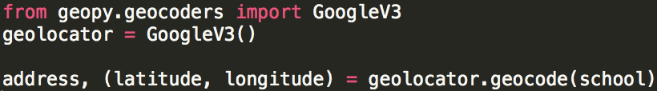
Using a geocoder
There are many types of geocoders, but we're going to use the GoogleV3 geocoder.
The variable school is just the name of a school. If you have an address, that works too!

Slide 13
It's open source
So take advantage!
https://github.com/shannonturner/seriously/blob/master/geocode.py
What's in the file schools_zero.txt?
And what does the code do?

Slide 14
What's in the file?
West Virginia Wesleyan College WV
West Virginia University at Parkersburg WV
Bluefield State College WV
Viterbo University WI
University of Wisconsin-Stevens Point WI
Mount Mary College WI
Milwaukee School of Engineering WI
Medical College of Wisconsin WI
Marian University WI
Madison Area Technical College WI
Edgewood College WI
…. and on and on …

Slide 15
What's the code do?
Opens a file
For each line in schools_zero.txt:
Use the geocoder on that school
Create a JSON* entry with the school name and coordinates
Write a file with the results called schools_zero.json

Slide 16
What is json?
It stands for JavaScript Object Notation
It's a way of storing information that's easy for both people and computers to read!

Slide 17
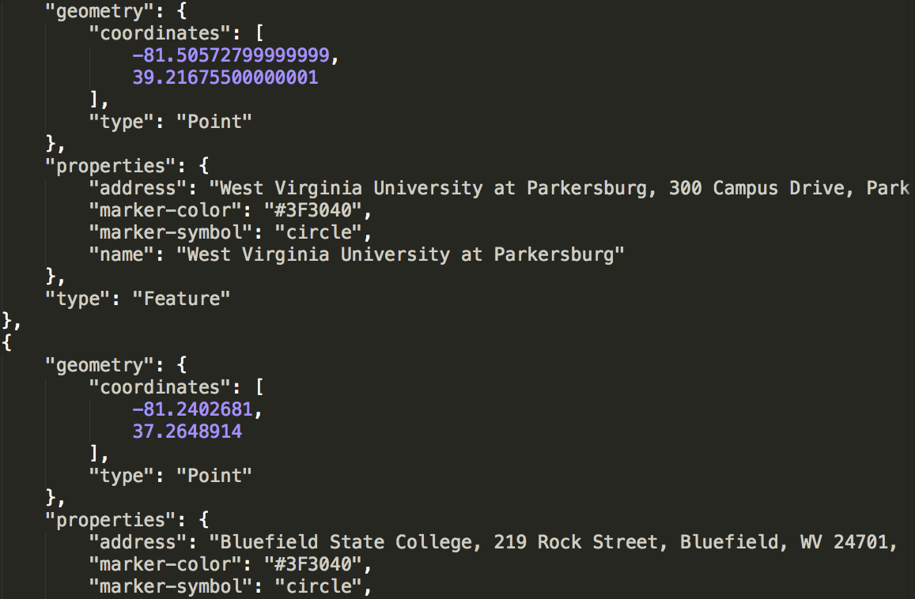
json looks like this

Slide 18
a shortcut
Paste your JSON with location info into Github and save the file
File text looks like: https://raw.githubusercontent.com/shannonturner/seriously/master/schools_zero.json
Github maps it for you: https://github.com/shannonturner/seriously/blob/master/schools_zero.json

Slide 19
questions? need help?
This was a quick intro - we skipped over a lot!
Email me!
shannon@hearmecode.com
Join the classes!
hearmecode.com

